Slide 1
DATA TYPES

Slide 2
Data type :
Each value has a data type, and variables can hold the values.
The interpreter binds the value implicitly to its type, So did not specify the type of the variable.
Python has the following data types,
Numbers
Sequence type
Boolean
Set
Dictionary

Slide 3
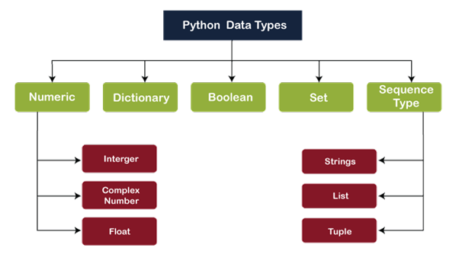

Slide 4
Numbers:
Numeric values are stored in numbers.
Python numbers data types are integer, float, complex.
Ex:
A=10
B=2.56
C=2+1j
print(type(A))
print(type(B))
print(type(C))
Output:
<class 'int'>
<class 'float'>
<class 'complex'>

Slide 5
Python supports four different numerical types. They are,
Binary
Decimal
Octal
Hexadecimal
Ex:
n=500
print(“The decimal value of”, n, “is:”)
print(bin(n),”in binary.”)
print(oct(n), ”in octal.”)
print(hex(n), “ in hexadecimal.”)
Output:
The decimal value of 500 is:
0b111110100 in binary.
0o764 in octal.
0x1f4 in hexadecimal.

Slide 6
Sequence type:
String
List
Tuple
String:
string is a sequence of characters written inside a single or double-quote.
Strings are immutable data types, therefore once declared, we can’t alter the string.
Ex:
var1=‘Hello World’
var2=“Python Programming”
print(var1)
print(var2)

Slide 7
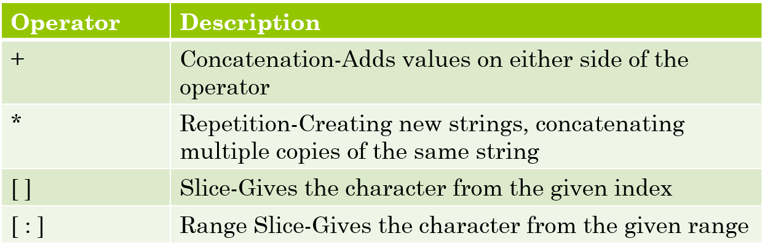
String Special Operators:

Slide 8
Example Program:
str="Hello World“
012345678910
print(str)
print(str[0])
print(str[2:7]) //2nd index-1
print(str[2:])
print(str[:2])
print(str * 2)
print(str+’TEST')
Output:
Hello World
H
llo W
llo World
He
Hello WorldHello World
Hello WorldTEST

Slide 9
String built in functions:
capitalize() : Capitalizes first letter of string.
join(seq) : Merges(concatenates) the string representations of elements in sequence into a string, with separator string.
len(string) : Return the length of the string.
max(str) : Returns the max alphabetical character from the string str.
min(str) : Returns the min alphabetical character from the string str.
title() : Returns “titlecased” version of string, that is, all words begin with uppercase and the rest are lowercase.
upper() : Converts lowercase letters in string to uppercase.
lower() : Converts uppercase letters in string to lowercase.

Slide 10
Example Program:
a="hello world"
b="HELLO"
print(a.capitalize())
print(‘-’.join(b))
print(len(a))
print(max(a))
print(min(b))
print(a.title())
print(a.upper())
print(b.lower())
print(a.find('r'))
print(a.replace('hello','hai’))
Output:
Hello world
H-E-L-L-O
11
w
E
Hello World
HELLO WORLD
hello
8
hai world

Slide 11
List:
Lists are a single storage unit to store multiple data items together.
It’s a mutable data structure, therefore, once declared, it can still be altered.
A list can hold strings, numbers, lists, tuples, dictionaries, etc.
To declare a list using square brackets [], containing comma-separated the values.
Accessing values from list use slicing. List are ordered & allow duplicate values.
Example:
list1 = ["Apple","Mango","Orange"]
print(list1)
list2 = list()
print(list2)
list3 = [2021,['hello', 2020],2.0]
print(list3)
Output:
['Apple', 'Mango', 'Orange']
[]
[2021, ['hello', 2020], 2.0]

Slide 12
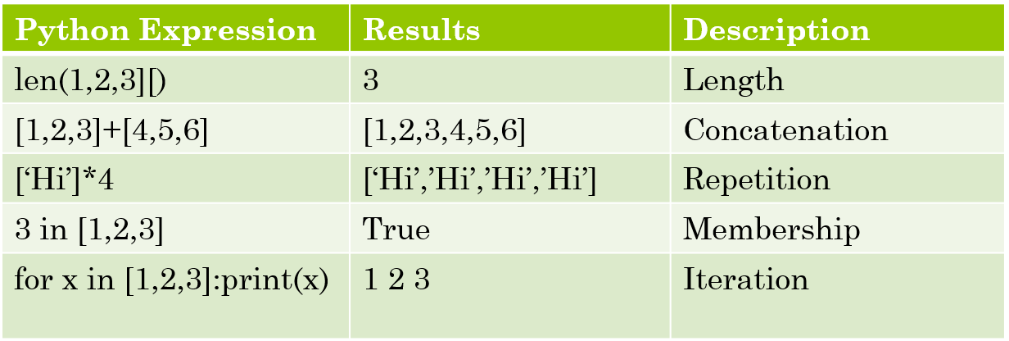
Basic List Operators:

Slide 13
Example Program:
list=['abcd',786, 2.23,'john',70.2]
list2=[123, 'john']
list3=list + list2
list4=['hi']
print(len(list))
print(list3)
print([list4 * 3])
print(123 in list2)
for x in list2:
print(x)
Output:
5
['abcd', 786, 2.23, 'john', 70.2, 123, 'john']
[['hi', 'hi', 'hi']]
True
123
john

Slide 14
Accessing value from list:
list1=[‘physics’, ’chemistry’, 1997,2000]
list2=[1,2,3,4,5,6,7]
print(“list1[0]:”,list1[0])
print(“list2[1:5]:”,list2[1:5])
Update in list:
list = [‘physics’,‘chemistry’,1997,2000]
print(“Value at index 2: “)
print(list[2])
list[2]=2001
print(“New value at index 2:”)
print(list[2])
Output:
list1[0]:physics
list2[1:5]:[2,3,4,5]
Output:
Value at index 2:
1997
New value at index 2:
2001

Slide 15
insert():
To insert a new list item, without replacing any of the existing values, we can use the insert() method.
Program:
thislist = ['apple', 'banana', 'cherry']
thislist.insert(1,"watermelon")
print(thislist)
Output:
['apple', 'watermelon', 'banana', 'cherry']

Slide 16
Delete item from list:
To remove a list element, use del statement.
Also use pop() & remove() method
Ex: (index value)
list1=[‘physics’ , ‘chemistry’ , 1997, 2000]
print(list1)
del list1[2]
print(“After deleting : “)
print(list1)
Output:
[‘physics’ , ‘chemistry’ , 1997, 2000]
After deleting :
[‘physics’ , ‘chemistry’ , 2000]
remove(): (element name)
list1.remove(‘chemistry’)
print(list1)
O/P
[‘physics’ , 1997, 2000]
pop(): (index value)
list1.pop(0)
print(list1)
O/P
[‘chemistry’ , 1997, 2000]

Slide 17
clear():
It delete all the element from the list.
It delete only the elements not the list.
Program:
thislist = ['banana', 'mango', 'orange']
thislist.clear()
print(thislist)
Output:
[]

Slide 18
append():
It is used to add only one element in the list.
It add the element at the end of the list.
Program:
thislist = ['apple', 'orange', 'banana']
print(thislist)
thislist.append('pineapple')
print(thislist)
Output:
['apple', 'orange', 'banana']
['apple', 'orange', 'banana', 'pineapple']

Slide 19
extend():
It is used to add more than one element in the list.
It also add one list with another list.
Program:
thislist = ['apple', 'orange', 'banana']
thislist2 = [2,4,6,8]
print(thislist)
thislist.extend(("cherry", "grapes"))
print(thislist)
thislist2.extend(thislist)
print(thislist2)
Output:
['apple', 'orange', 'banana']
['apple', 'orange', 'banana', 'cherry', 'grapes']
[2, 4, 6, 8, 'apple', 'orange', 'banana', 'cherry', 'grapes']

Slide 20
Built in functions:
len(list) : Gives the total length of the list
max(list) : Returns item from the list with max value.
min(list) : Returns item from the list with min value
list(seq) : converts a tuple into list
Ex:
my_list=[5,6,7,8,9,10]
tuple1=(1,2,3)
print(my_list)
print(len(my_list))
print(max(my_list))
print(min(my_list))
print(my_list.index(10))
print(tuple1)
print(list(tuple1))
Output:
[5, 6, 7, 8, 9, 10]
6
10
5
5
(1, 2, 3)
[1, 2, 3]

Slide 21
List methods:
list.append(obj) :Appends object obj to list
list.count(obj) :Returns count of how many times obj occurs in list
list.extend(seq) :Appends the contents of seq to list
list.index(obj) :Returns the lowest index in list that obj appears.
list.remove(obj) :Removes object obj from list
list.reverse() :Reverse objects of list in place

Slide 22
Program:
listone = [1,2,3,4,5,6,7,8,9]
list2=["mango", "orange", "apple"]
print(listone)
listone.append(10)
print(listone)
x=list2.count('mango')
print(x)
print(list2)
list2.extend(listone)
print(list2)
print(listone.index(3))
listone.remove(5)
print(listone)
list2.reverse()
print(list2)
Output:
[1, 2, 3, 4, 5, 6, 7, 8, 9]
[1, 2, 3, 4, 5, 6, 7, 8, 9, 10]
1
['mango', 'orange', 'apple']
['mango', 'orange', 'apple', 1, 2, 3, 4, 5, 6, 7, 8, 9, 10]
2
[1, 2, 3, 4, 6, 7, 8, 9, 10]
[10, 9, 8, 7, 6, 5, 4, 3, 2, 1, 'apple', 'orange', 'mango']

Slide 23
Tuples:
They are immutable and ordered.
It allows duplicate values.
The values stored in a tuple can be any type.
Tuples are indexed just like as list.
Tuples are written with round brackets.
Example:
tup1=('Maths' , 'Chemistry' , 1996 ,2021)
tup2=(1,2,3,4,5,6,7)
tup3="a" , "b" , "c" , "d"
tup4=tuple()
print(tup1)
print(tup2)
print(tup3)
print(tup4)
Output:
('Maths', 'Chemistry', 1996, 2021)
(1, 2, 3, 4, 5, 6, 7)
('a', 'b', 'c', 'd')
()

Slide 24
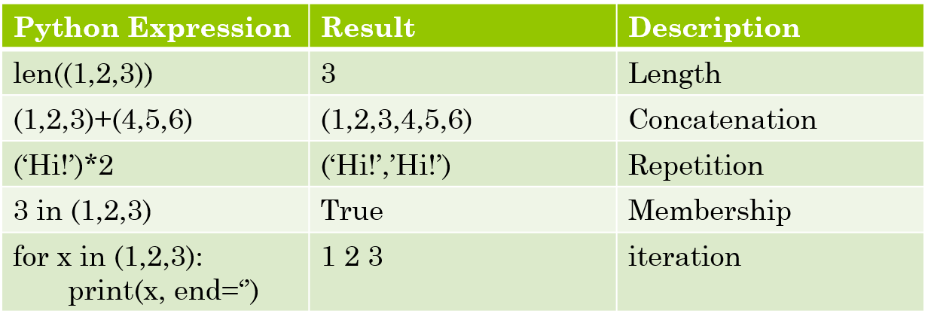
Basic tuples operations

Slide 25
Program:
list=('abcd',786, 2.23,'john',70.2)
list2=(1,2,3, 'john')
list3=list + list2
list4=('hi')
print(len(list))
print(list3)
print((list4 * 3))
print(123 in list2)
for x in list2:
print(x)
Output:
5
('abcd', 786, 2.23, 'john', 70.2, 1, 2, 3, 'john')
hi!hi!hi!
False
1
2
3
john

Slide 26
Accessing value in Tuples:
Use slicing to accesss values from the tuples.
Program:
tup1=("Maths" , "Chemistry" , 1996 ,2021)
tup2=(1,2,3,4,5,6,7)
print("tup1[0]: ", tup1[0])
print("tup2[1:5]: ", tup2[1:5])
Output:
tup1[0]: Maths
tup2[1:5]: (2, 3, 4, 5)

Slide 27
Deleting Tuples:
Removing individual tuple elements is not possible.
To remove an entire tuple, use the del statement.
Program:
tup1=(‘Maths’ , ‘Chemistry’ , 1996 ,2021)
del tup1;
Built in tuple function:
len(tuple) :Gives the total length of the tuple
max(tuple) :Returns item from the tuple with max value
min(tuple) :Returns item from the tuple with max value
tuple(seq) :Converts a list into tuple

Slide 28
Program:
my_tuple=('p', 'y', 't', 'h','o','n', 'p','r', 'o', 'g', 'r', 'a', 'm')
print(my_tuple.count('p'))
print(my_tuple.index('n'))
print('a' in my_tuple)
print(len(my_tuple))
print(my_tuple[-5])
print(max(my_tuple))
print(min(my_tuple))
Output:
2
5
True
13
o
y
a

Slide 29
Set:
Sets are used to store multiple items in a single variable.
A set is a collection of unordered.
Unchangeable.
No indexing.
Sets are written with curly brackets .
Duplicates not allowed.
Program:
thisset = {"mango", "orange", "apple"}
print(thisset)
print(len(thisset))
Output:
{'apple', 'orange', 'mango'}
3

Slide 30
Dictionary:
It used to store data values in key:value format. eg. { ‘Year’: 2024}
A dictionary is an associative array.
Keys are unique and immutable within a dictionary.
Values in dictionary can be of any data type and can be duplicated.
It is ordered and changeable.
Dictionaries are written with curly brackets.
Program:
dict={'Name' : 'zara' , 'Age' : 7 , 'Class' : 'First'}
dict1={'Name' :'jerry' , 1:[2,4,3] }
print(dict)
print(dict1)
Output:
{'Name': 'zara', 'Age': 7, 'Class': 'First'}
{'Name': 'jerry', 1: [2, 4, 3]}

Slide 31
Accessing values in Dictionary:
To access dictionary elements, use the square brackets along with the key to obtain its values.
Program:
dict={'Name' : 'zara' , 'Age' : 7 , 'Class' : 'First'};
print("dict['Name'] : " , dict['Name']);
print("dict['Age'] : " , dict['Age’]);
Output:
dict['Name'] : zara
dict['Age'] : 7

Slide 32
Updating Dictionary:
Update a dictionary by adding a new entry or a key-value pair, modifying an existing entry, or deleting an existing entry.
Program:
dict={'Name' : 'zara' , 'Age' : 7 , 'Class' : 'First'};
print(dict)
dict['Age'] = 8;
dict['School'] = "DPS School";
print(dict)
Output:
{'Name': 'zara', 'Age': 7, 'Class': 'First'}
{'Name': 'zara', 'Age': 8, 'Class': 'First', 'School': 'DPS School'}

Slide 33
Delete Dictionary element Program:
dict={'Name' : 'zara' , 'Age' : 7 , 'Class' : 'First'}
print(dict)
del dict['Name']
print(dict)
print(dict.pop(Class))
dict.clear()
print(dict)
del dict
print(dict)
Output:
{'Name': 'zara', 'Age': 7, 'Class': 'First'}
{'Age': 7, 'Class': 'First'}
{'Age': 7}
{}
<class 'dict'>

Slide 34
Nested dictionary:
A dictionary within the dictionary.
Program:
dict={ 1: 'aaa', 2:'bbb',3:{'A':111,'B':222}}
print(dict[3])
print(dict)
Output:
{'A': 111, 'B': 222}
{1: 'aaa', 2: 'bbb', 3: {'A': 111, 'B': 222}}

Slide 35
Dictionary built in functions:
len(dict) :Gives the total length of the dictionary.
str(dict) :Produces a printable string representation of a dictionary
type(variable) :Returns the type of the passed variable.
Program:
dict = {1:2,7:3,5:8,'Hi' : 'Ravi', 'odd' : 7}
print(dict)
print(str(dict))
print(list(dict))
Output:
{1: 2, 7: 3, 5: 8, 'Hi': 'Ravi', 'odd': 7}
{1: 2, 7: 3, 5: 8, 'Hi': 'Ravi', 'odd': 7}
[1, 7, 5, 'Hi', 'odd']

Slide 36
Program:
dict = {}
print(dict)
dict[0] = 'Geeks'
dict[2] = 'For'
dict[3] = 1
print(dict)
dict['Value-Set'] = 2, 3, 4
print(dict)
dict[2] = 10
print(dict)
dict[5] = {'nested' : {'1' : 'life', '2' : 'geeks'}}
print(dict)
Output:
{}
{0: 'Geeks', 2: 'For', 3: 1}
{0: 'Geeks', 2: 'For', 3: 1, 'Value-Set': (2, 3, 4)}
{0: 'Geeks', 2: 10, 3: 1, 'Value-Set': (2, 3, 4)}
{0: 'Geeks', 2: 10, 3: 1, 'Value-Set': (2, 3, 4), 5: {'nested': {'1': 'life', '2': 'geeks'}}}

Slide 37
Exercise:
Write a program in python to check all the list functions?
Write a program in python to check all the string functions?
Write a program in python to check all the tuple functions?
Write a program in python to check all the Dictionary functions?

Slide 38
ASCII value :
a – z → a=97, b=98, …………….., z=122
A – Z → A=65, B=66, …………....., Z=90

